Slide 1
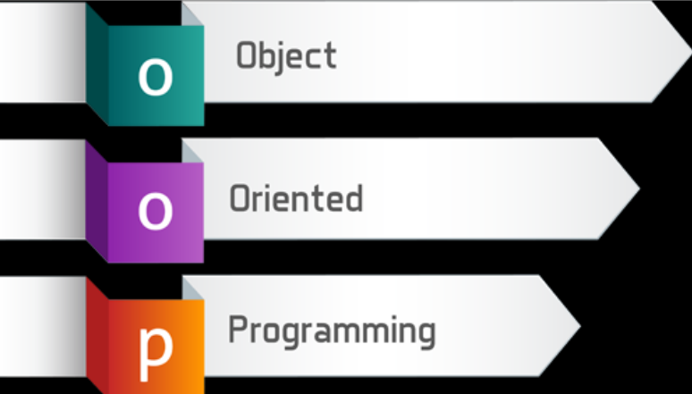
Programming in Java

Slide 2

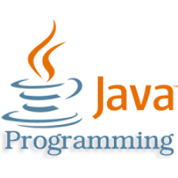
Introduction to Java

Slide 3

Java an Introduction
Java is a powerful programming language built to be secure, cross-platform and international, but Java is being continuously extended to provide language features and libraries that elegantly handle problems that are difficult in traditional programming languages, such as multithreading, database access, network programming and distributed computing. Java allows client-side programming via the applet.

Slide 4
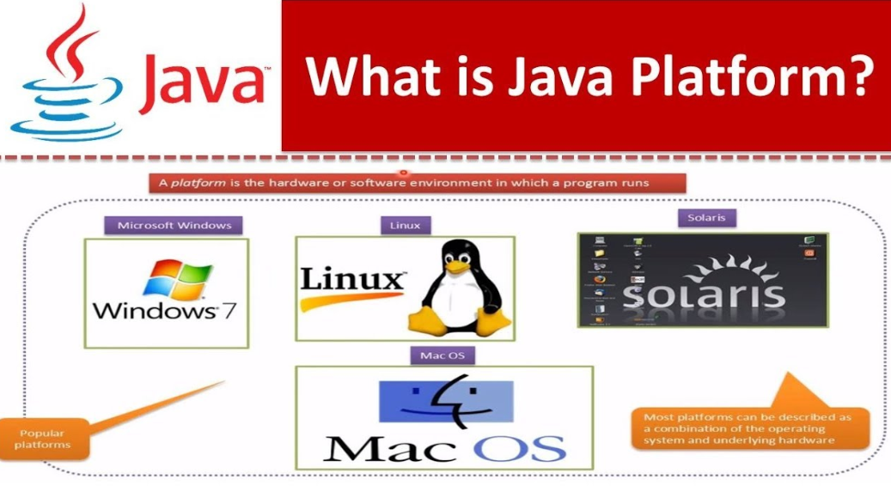

Slide 5
What is Java
Java is an object-oriented programming language developed by Sun Microsystems, a company best known for its high-end Unix workstations. Modeled after C++, the Java language was designed to be small, simple, and portable across platforms and operating systems.
Java is also a platform.
Any hardware or software environment in which a program runs, is known as a platform. Since Java has its own runtime environment (JRE) and API, it is called platform.

Slide 6


History
James Gosling, Mike Sheridan, and Patrick Naughton initiated the Java language project
in June 1991 at Sun Microsystems. The small
team of sun engineers called Green Team.
After that, it was called Oak and was developed as a part of the Green project.
Oak was renamed as JAVA on May 20, 1995, by Sun Microsystems.
HotJava
The first Java-enabled Web browser
JDK Evolutions
J2SE, J2ME, and J2EE
6

Slide 7
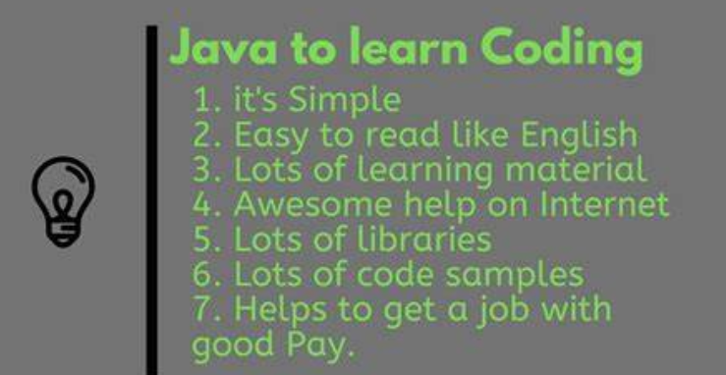
Why to Learn Java?
Java Is Platform-Independent
Platform-independence is a program’s capability of moving easily from one computer system to another
Java Is Object-Oriented
Java is modeled after C and C++
Java Is Easy to Learn
There are no pointers in Java, nor is there pointer arithmetic. Strings and arrays are real objects in Java. Memory management is automatic.

Slide 8

According to Sun, Java is...
Simple and Powerful
Object Oriented
Portable
Architecture Neutral
Distributed
Multi-threaded
Robust, Secure/Safe
Interpreted
High Performance
Dynamic programming language/platform.

Slide 9
As a whole, Java is a Comprehensive Programming Solution
Object Oriented
Portable
High Performance
Geared for Distributed Environments
Secure
Multithreading
Dynamic

Slide 10
JDK Versions
Release | Year
JDK Beta | 1995
JDK 1.0 | 1996
JDK 1.1 | 1997
J2SE 1.2 | 1998
J2SE 1.3 | 2000
J2SE 1.4 | 2002
J2SE 5.0 | 2004
Java SE 6 | 2006
Java SE 7 | 2011
Java SE 8 | 2014
10

Slide 11
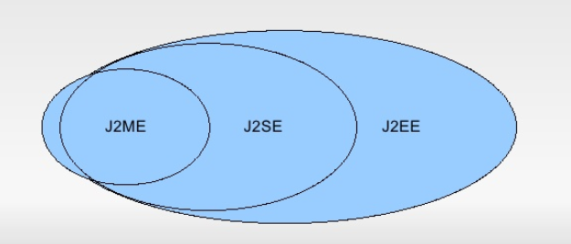
JDK Editions
Java Standard Edition (J2SE)
J2SE can be used to develop client-side standalone applications or applets.
Java Enterprise Edition (J2EE)
J2EE can be used to develop server-side applications such as Java servlets and Java ServerPages.
Java Micro Edition (J2ME).
J2ME can be used to develop applications for mobile devices such as cell phones.
11

Slide 12
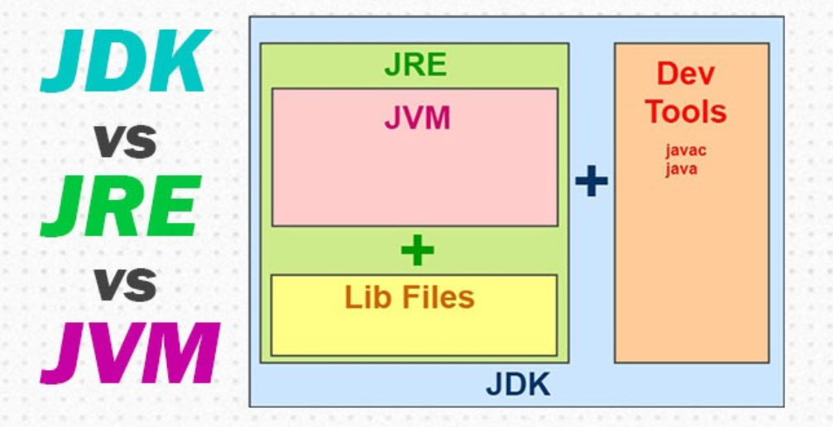
JDK vs JRE vs JVM

Slide 13
JDK vs JRE vs JVM
JDK (Java Development Kit)
JDK contains everything that will be required to develop and run Java application.
JRE (Java Run time Environment)
JRE contains everything required to run Java application which has already been compiled. It doesn’t contain the code library required to develop Java application.
JVM (Java Virtual Machine)
JVM is a virtual machine which work on top of your operating system to provide a recommended environment for your compiled Java code. JVM only works with bytecode. Hence you need to compile your Java application(.java) so that it can be converted to bytecode format (also known as the .class file). Which then will be used by JVM to run application.

Slide 14
JDK vs JRE vs JVM
Java Development Kit (JDK) consists of Java Runtime Environment (JRE) along with tools to compile and debug Java code for developing Java applications. JRE consists of libraries, Java Virtual Machine (JVM), Java Plugin and Java Web Start to run Java applications. JRE as a stand-alone does not contain compilers and debugging tools.

Slide 15
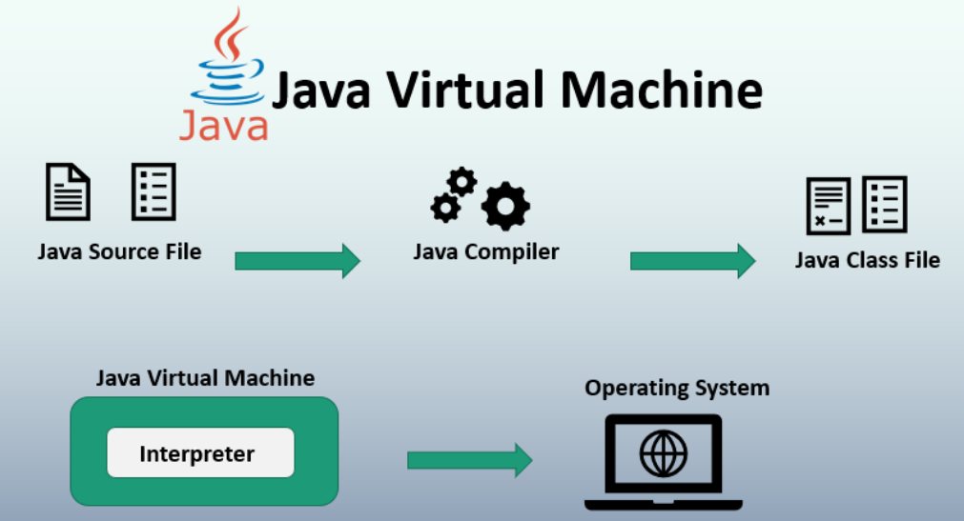
JVM (Java Virtual Machine)
JVM is a virtual machine or a program that provides run-time environment in which java byte code can be executed. JVMs are available for many hardware and software platforms. The use of the same byte code for all JVMs on all platforms make java platform independent.

Slide 16
JVM (Java Virtual Machine)
Main task of JVM:
1. Search and locate the required files.
2. Convert byte code into executable code.
3. Allocate the memory into ram
4. Execute the code.
5. Delete the executable code

Slide 17
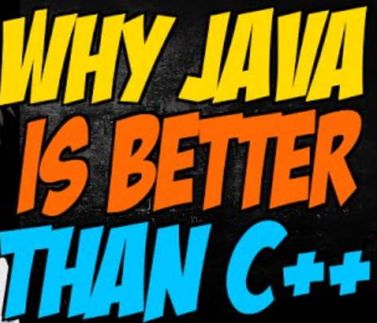
Java better than C++ ?
No Typedefs, Defines, or Preprocessor
No Global Variables
No Goto statements
No Pointers
No Unsafe Structures
No Multiple Inheritance
No Operator Overloading
No Automatic Coercions
No Fragile Data Types

Slide 18
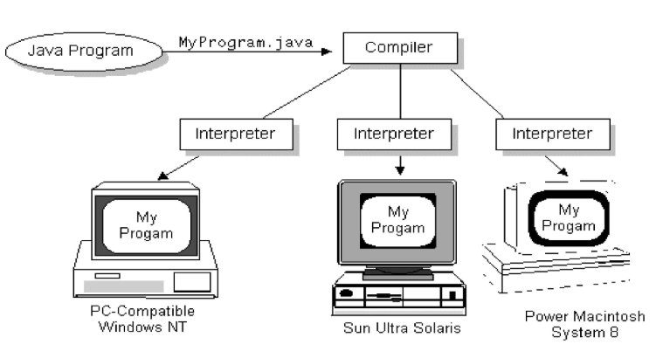
Base concept of java language
Write once, run anywhere (WORA) – that means java program can run anywhere and on any platform. When java code is compiled it is converted into byte code. Now only this byte code is needed to run using JVM, no need of source code and recompilation.

Slide 19
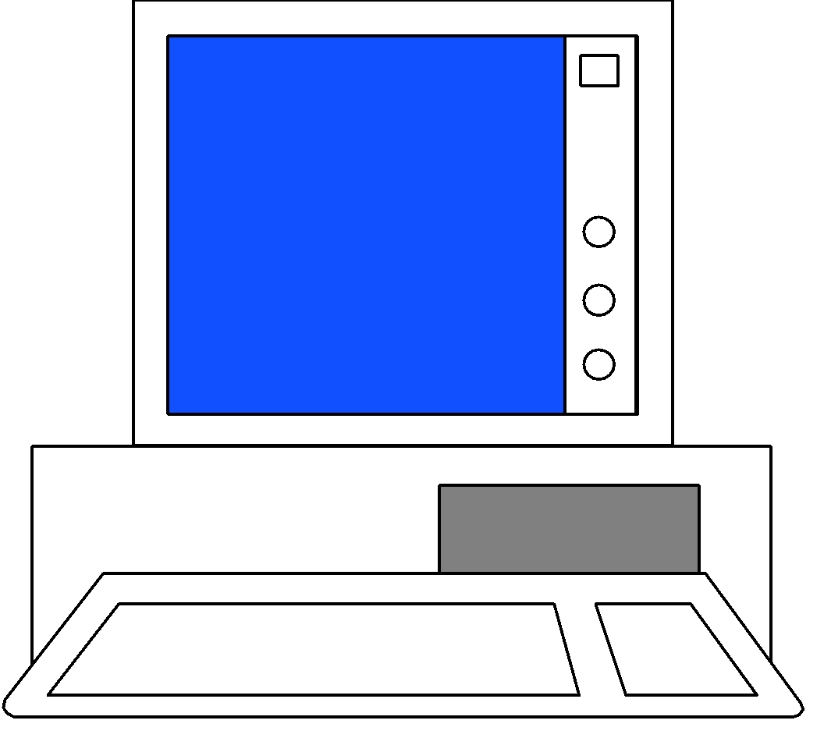
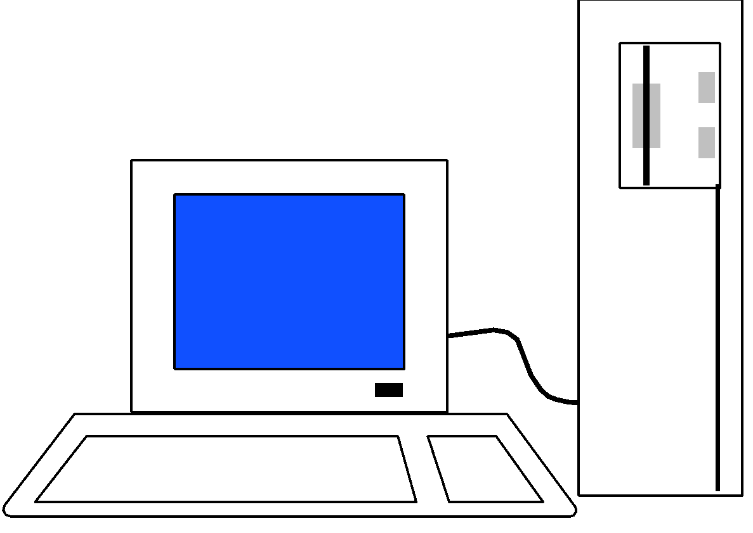
Total Platform Independence
JAVA COMPILER
(translator)
JAVA BYTE CODE
(same for all platforms)
JAVA INTERPRETER
(one for each different system)
Windows 95
Macintosh
Solaris
Windows NT

Slide 20
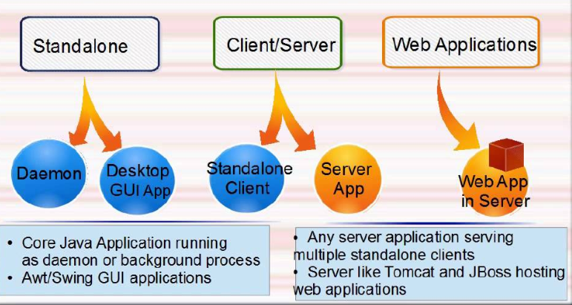
Types of Java Applications

Slide 21
Types of Java Applications
1) Standalone Application
It is also known as desktop application or window-based application. An application that we need to install on every machine such as media player, antivirus etc. AWT and Swing are used in java for creating standalone applications.
2) Web Application
An application that runs on the server side and creates dynamic page, is called web application. Currently, servlet, jsp, struts, jsf etc. technologies are used for creating web applications in java.
3) Enterprise Application
An application that is distributed in nature, such as banking applications etc. It has the advantage of high level security, load balancing and clustering. In java, EJB is used for creating enterprise applications.
4) Mobile Application
An application that is created for mobile devices. Currently Android and Java ME are used for creating mobile applications.

Slide 22

Application of Java
Java is widely used in every corner of world and of human life. Java is not only used in softwares but is also widely used in designing hardware controlling software components. There are more than 930 million JRE downloads each year and 3 billion mobile phones run java.
Following are some other usage of Java :
Developing Desktop Applications
Web Applications like Linkedin.com, Snapdeal.com etc
Mobile Operating System like Android
Embedded Systems
Robotics and games etc.

Slide 23
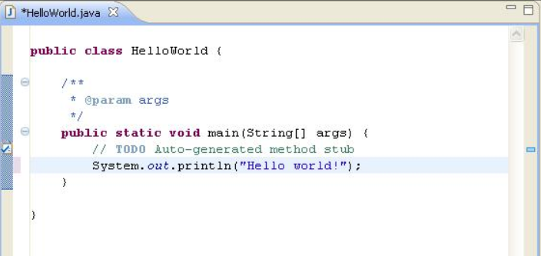
First Java Program

Slide 24
First Java Program
The keyword 'public' says that, the main function can be accessed even outside the defining class.
The keyword 'static' indicates that a function can be accessed without an object.
The keyword 'void' indicates that a function returns nothing.
The Keyword 'main' is the name of the function and entry point for a Java application.

Slide 25
Variants of main() in Java
Default:
public static void main(String args[])
Variants:
static public void main(String args[])
public static void main(String[] args)
public final static void main(String[] args)
public synchronized static void main(String[] args)
The main() can be overloaded but not overridden.

Slide 26
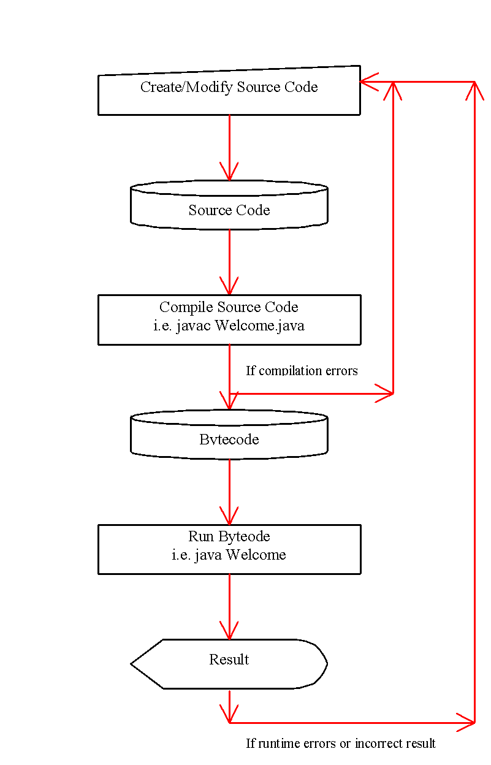
Creating and Compiling Programs
On command line
javac file.java
26

Slide 27
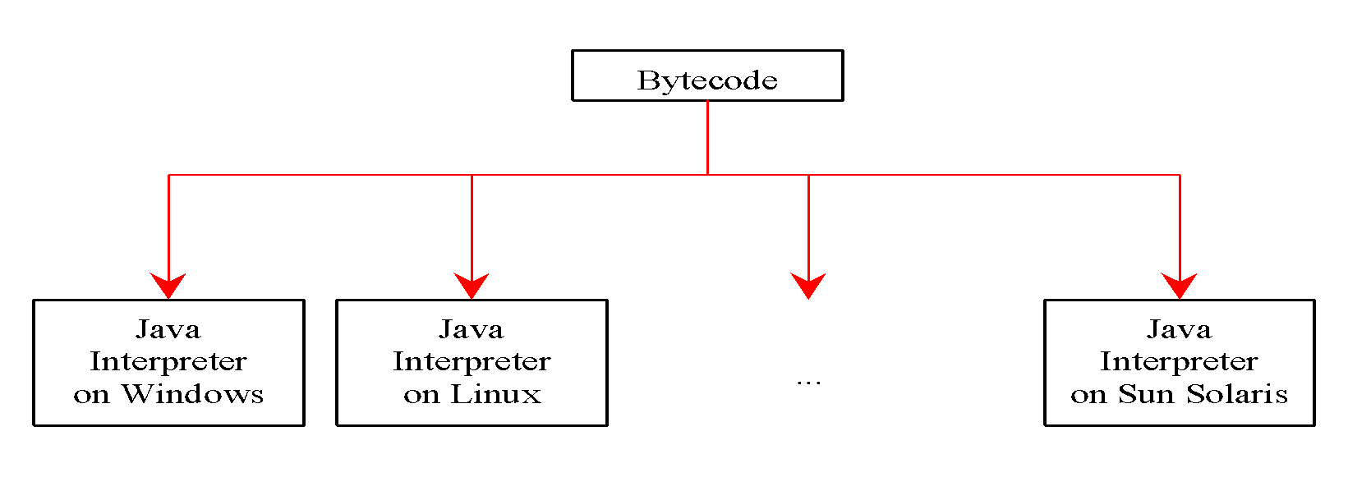
Executing programs
On command line
java classname
javac Welcome.java
java Welcome
output:...

Slide 28
Java Installation
Is java already installed
java –version
To install java on ubuntu run the following commands sequentially.
sudo apt-get install python-software-properties
sudo add-apt-repository ppa:sun-java-community-team/sun-java6
sudo apt-get update
sudo apt-get install sun-java6-jdk

Slide 29
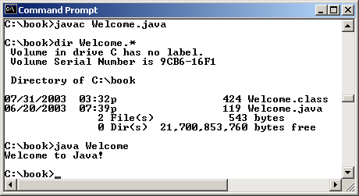
Compiling and Running Java from the Command Window
Set path to JDK bin directory
set path=c:\Program Files\java\jdk1.6.0\bin
Compile
javac Welcome.java
Run
java Welcome
29

Slide 30
Popular Java Editors
To write your Java programs, you will need a text editor. There are even more sophisticated IDEs available in the market. But for now, you can consider one of the following:
Notepad: On Windows machine you can use any simple text editor like Notepad, TextPad. On Ubuntu you can use Gedit or VIM
Netbeans: is a Java IDE that is open-source and free which can be downloaded
Eclipse: is also a Java IDE developed by the eclipse open-source community and can be downloaded.

Slide 31
Java Coding Guidelines
About Java programs, it is very important to keep in mind the following points.
Case Sensitivity - Java is case sensitive, which means identifier Hello and hello would have different meaning in Java.
Class Names - For all class names the first letter should be in Upper Case. If several words are used to form a name of the class, each inner word's first letter should be in Upper Case. Eg. class MyFirstJavaClass
Method Names - All method names should start with a Lower Case letter. Eg. public void myMethodName()
Program File Name - Name of the program file should exactly match the class name. When saving the file, you should save it using the class name and append '.java' to the end of the name. If the file name and the class name do not match your program will not compile. Example: Assume 'MyFirstJavaProgram' is the class name. Then the file should be saved as 'MyFirstJavaProgram.java'
public static void main(String args[]) - Java program processing starts from the main() method which is a mandatory part of every Java program.

Slide 32
Java Coding Guidelines
Naming variable:
Use first word in small letters and all remaining words will be capitalized. E.g. – rollNumber, firstName.
Naming Constants:
Use all letters in upper case. E.g. – MAX_MARKS.
Comment:
For clarity of the code add comments.

Slide 33
Comments in Java
Three types of comments in Java
Line comment: A line comment is preceded by two slashes (//) in a line.
Paragraph comment: A paragraph comment is enclosed between /* and */ in one or multiple lines.
javadoc comment: javadoc comments begin with /** and end with */. They are used for documenting classes, data, and methods. They can be extracted into an HTML file using JDK's javadoc command.
33

Slide 34
Java Identifiers:
All Java components require names. Names used for classes, variables and methods are called identifiers.
Java Modifiers:
Access Modifiers: default, public , protected, private
Non-access Modifiers: final, abstract, strictfp
Java Variables:
Local Variables
Class Variables (Static Variables)
Instance Variables (Non-static variables)

Slide 35

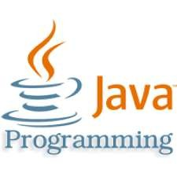

Slide 36

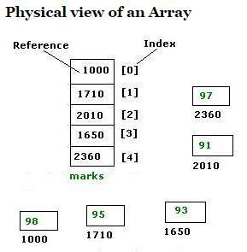
▣ In java arrays are objects. All methods of an Object can be invoked on an array. Arrays are stored in heap memory.

Slide 37
▣ Array Declaration
//Single Dimensional Array
int[] arr; //recommended
int arr[];
//Multi Dimensional Array
int[][] arr; //recommended
int arr[][];
int[] arr[];
▣ Array Instantiation
marks = new int[5];
▣ Java array initialization and instantiation together
int marks[] = {98, 95, 91, 93, 97};

Slide 38
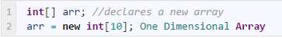
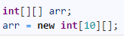
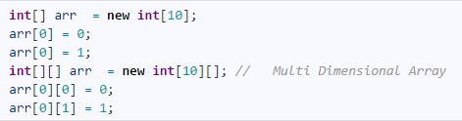
▣ One Dimensional Array
▣ New keyword will be used to construct one/multi dimensional array.
▣ Two Dimensional Array
▣ These are array of arrays. So a two dimensional array is array of arrays of int
▣ Initializing Array

Slide 39

public class Test {
public static void main(String[] args) {
int[] values = new int[5]; for (int i = 1; i < 5; i++) { values[i] = i + values[i-1];
}
values[0] = values[1] + values[4];
}
}
After the fourth iteration
0
1
2
0
1
3
3
6
4
10

Slide 40

myList.length=5;
java.util.Scanner input = new java.util.Scanner(System.in);
System.out.print("Enter " + myList.length + " values: ");
for (int i = 0; i < myList.length; i++) myList[i] = input.nextDouble();
▣ Initializing arrays with random values
for (int i = 0; i < myList.length; i++)
{
myList[i] = Math.random() * 100;
}

Slide 41

// Declare array ref var dataType[][] refVar;
// Create array and assign its reference to variable
refVar = new dataType[10][10];
// Combine declaration and creation in one statement
dataType[][] refVar = new dataType[10][10];
// Alternative syntax
dataType refVar[][] = new dataType[10][10];
7

Slide 42

Each row in a two-dimensional array is itself an array. So, the rows can have different lengths. Such an array is known as a ragged array. For example,
int[][] triangleArray = {
1 2 3 4 5
{1, | 2, | 3, | 4, | 5},
{2, | 3, | 4, | 5},
{3, | 4, | 5},
{4, | 5},
{5}
1 2 3 4
1 2 3
};
1 2
1 2
8

Slide 43

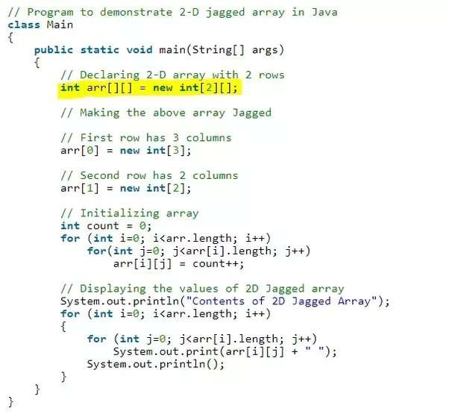
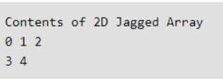

Slide 44
Flow control
Basically, it is exactly like c/c++.
do/while
switch
int i=5;
do {
// act1
i--;
} while(i!=0);
if/else
char c=IN.getChar();
switch(c) {
case ‘a’:
case ‘b’:
// act1
break;
default:
// act2
}
If(x==4) {
// act1
} else {
// act2
}
for
int j;
for(int i=0;i<=9;i++)
{
j+=i;
}

Slide 45
If else statement

Slide 46
switch Statements
switch (status) {
case 0: compute taxes for single filers;
break;
case 1: compute taxes for married file jointly;
break;
case 2: compute taxes for married file separately;
break;
case 3: compute taxes for head of household;
break;
default: System.out.println("Errors: invalid status");
System.exit(0);
}
46

Slide 47
switch Statements

Slide 48
Flow control contd…
break is used in the loops and when executed, the control of the execution will come out of the loop.
continue makes the loop to skip the current execution and continues with the next iteration.
return statement can be used to cause execution to branch back to the caller of the method.
Labeled break and continue statements will break or continue from the loop that is mentioned. Used in nested loops.

Slide 49
For loop

Slide 50
While and do while

Slide 51

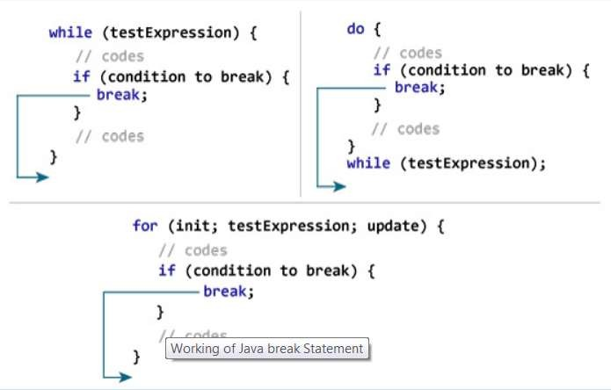

Slide 52

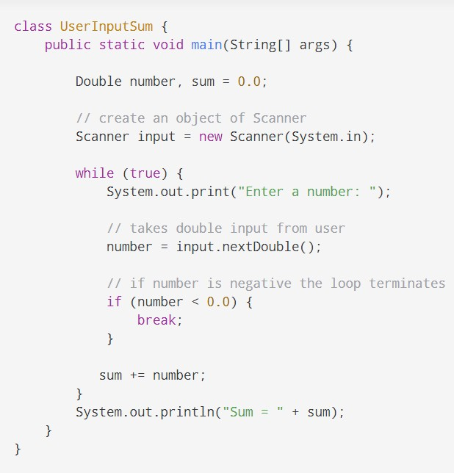
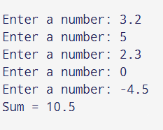

Slide 53
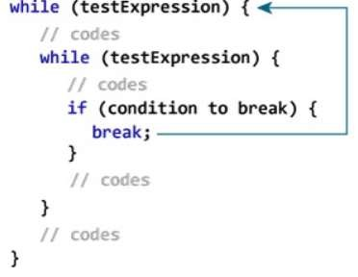

Slide 54
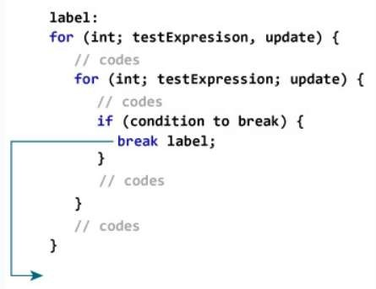
▣ We can use the labeled break statement to terminate the outermost loop.

Slide 55
public class JavaBreakLabel {
public static void main(String[] args) { int[]arr = { 1,2,3,4,5,6,7,6,8,9,10 };
boolean found = false;
int row = 0;
// find index of first int greater than 5
searchint:
for (row = 0; row < arr.length; row++) {
if (arr[row] > 5) {
found = true;
// using break label to terminate outer statements break searchint;
}
}
if (found)
System.out.println("First int greater than 5 is found at index: [" + row + "] and the
element is "+arr[row]);
}
}

Slide 56
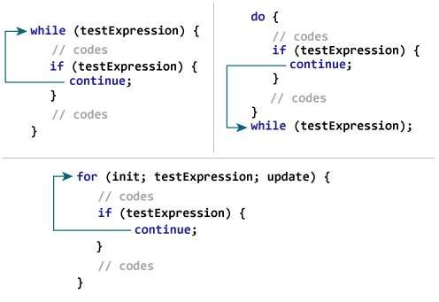

Slide 58
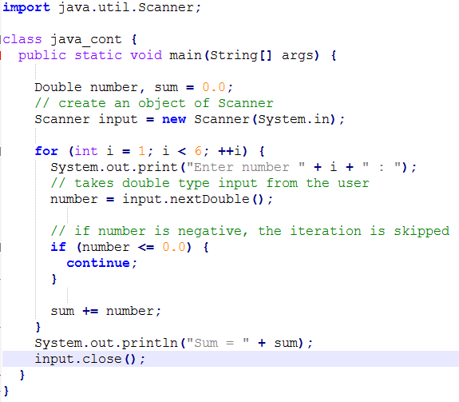
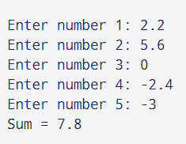

Slide 59
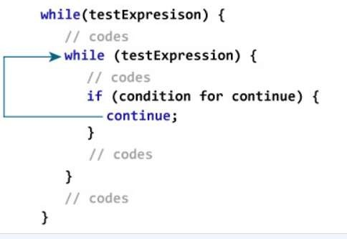

Slide 60
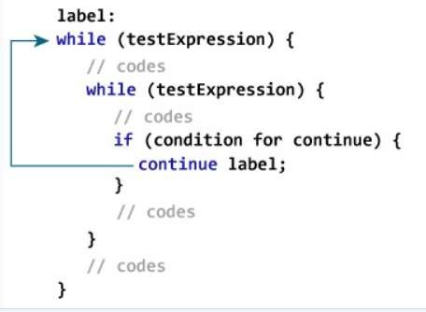
▣ It is used to terminate the innermost loop and switch statement. However, there is another form of continue statement in Java known as labeled continue.

Slide 61
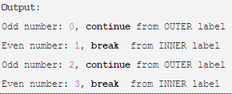
Java continue statement with label example
public class BreakContinueWithLabel { public static void main(String args[]) { int[] numbers= new int[]{100,18,21,30}; //Outer loop checks if number is multiple of 2 OUTER: //outer label for(int i = 0; i<numbers.length; i++)
{ if(i % 2 == 0)
{ System.out.println("Odd number: " + i + ", continue from OUTER label"); continue OUTER; } INNER: for(int j = 0; j<numbers.length; j++)
{ System.out.println("Even number: " + i + ", break from INNER label"); break INNER; } } } }

Slide 62
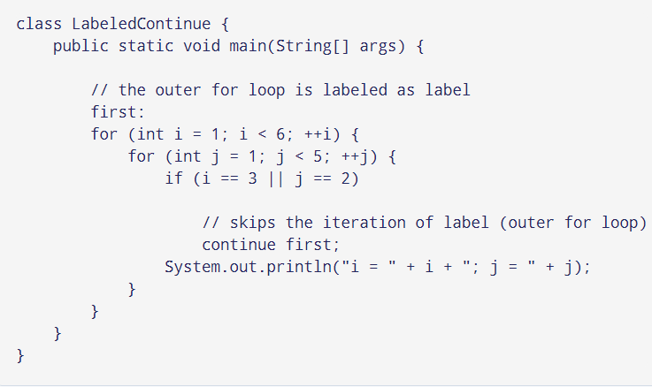
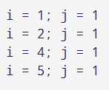

Slide 64
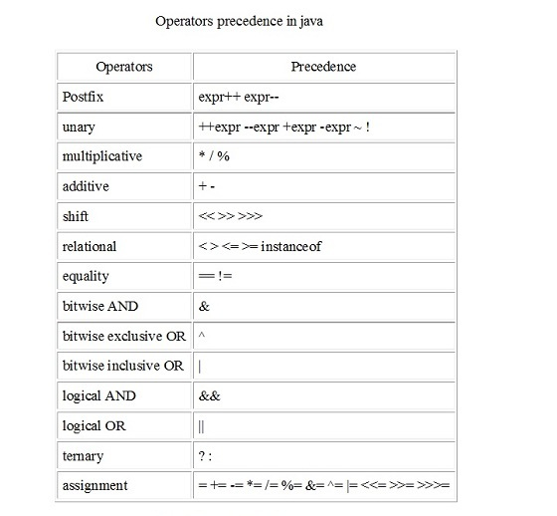
Operators in Java

Slide 65
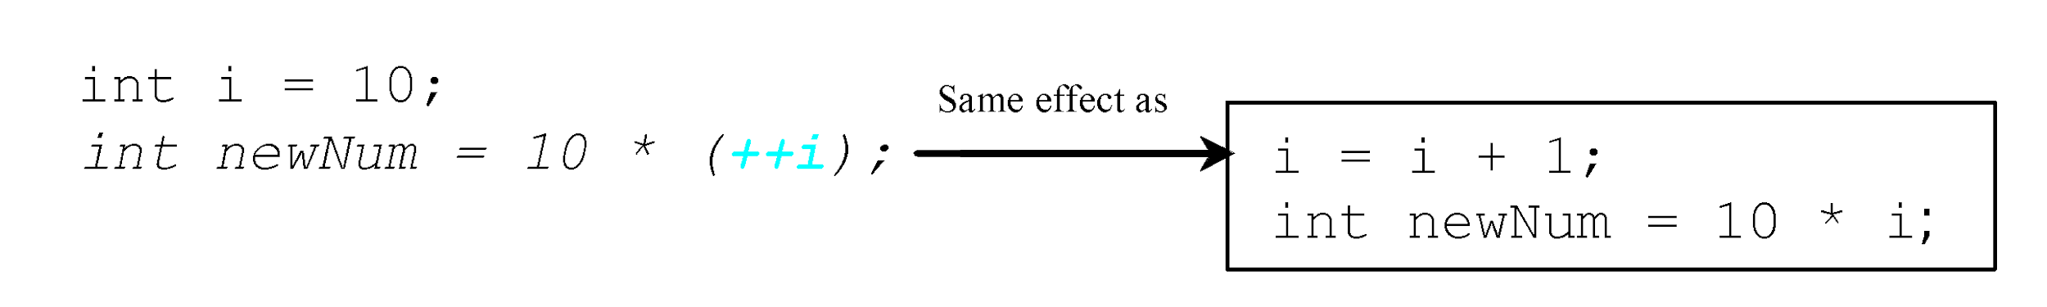
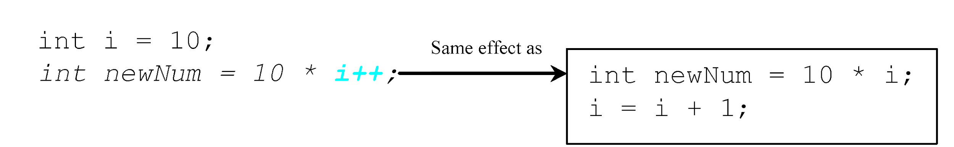
Increment and Decrement Operators
65

Slide 66
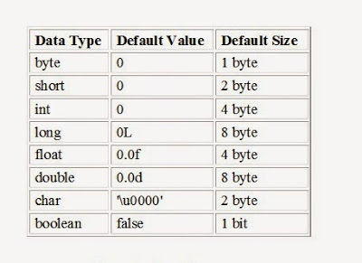
Data Types in Java
In java, data types are classified into two catagories :
Primitive Data type
Non-Primitive Data type are Referenced or object data types:
is used to refer to an object. A reference variable is declare to be of specific and that type can never be change. Default value of object data types is null.
Note: Compiler never initialize local variable with default values. So you have to initialize local variable before using otherwise it will result in compile-time error

Slide 67
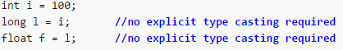
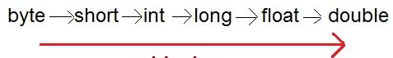
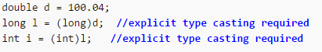
Type Casting
Assigning a value of one type to a variable of another type is known as Type Casting.
Automatic Type casting (Implicit) take place when, the two types are compatible and the target type is larger than the source type.
Explicit type casting: When you are assigning a larger type value to a variable of smaller type, then you need to perform explicit type casting.

Slide 68
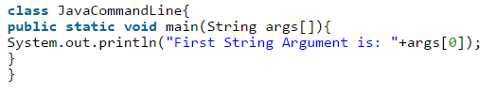
Java Command Line Argument
Command line arguments are the optional argument that supplied by the user or programmer at run time. In java command line arguments are handled by the main() function. It is an Array of string so that you can pass argument in the form of String only.

Slide 69
Reading Input from the Console
1. import java.util.Scanner;
2. Create a Scanner object
Scanner input = new Scanner(System.in);
3. Use the methods next(), nextByte(), nextShort(), nextInt(), nextLong(), nextFloat(), nextDouble(), or nextBoolean() to obtain to a string, byte, short, int, long, float, double, or boolean value. For example,
System.out.print("Enter a double value: ");
Scanner input = new Scanner(System.in);
double d = input.nextDouble();
69

Slide 70
An Overview of Java
Object-Oriented Programming
Object-oriented programming (OOP) is at the core of Java.
In fact, all Java programs are to at least some extent object-oriented.
Two Paradigms
Process-Oriented Model
Object-Oriented Programming

Slide 71
An Overview of Java
Process-Oriented Model
This approach characterizes a program as a series of
linear steps (that is, code).
The process-oriented model can be thought of as code acting on data.
Object-Oriented Programming
This approach organizes a program around its data (that is, objects) and a set of well-defined interfaces to that data.
An object-oriented program can be characterized as
data controlling access to code.

Slide 72
OOP Principles
Abstraction is a process where you show only “relevant” data and “hide” unnecessary details of an object from the user.
We use abstract classes and interfaces to achieve abstraction in java.
Ex: Working of a Car, Working of a Projector, Working of a Computer Working of an ATM.

Slide 73
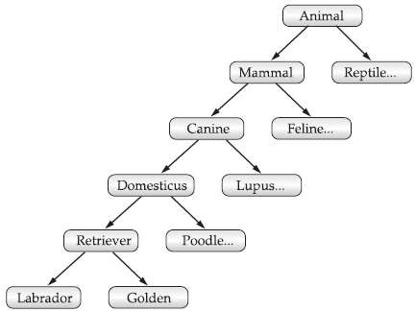
OOP Principles
Inheritance
When one object acquires all the properties and behaviors of parent object i.e. known as inheritance.
It provides code reusability.
It is used to achieve runtime polymorphism.

Slide 74
OOP Principles
Inheritance
Without the use of hierarchies, each object would need to define all of its characteristics explicitly.
However, by the use of inheritance, an object need only define those qualities that make it unique within its class.
It can inherit its general attributes from its parent.
Thus, it is the inheritance mechanism that makes it possible for one object to be a specific instance of a more general case.

Slide 75
OOP Principles
Polymorphism
Polymorphism is a feature that allows one interface to be used for a general class of actions.
In java, we use method overloading and method overriding to achieve polymorphism.
Ex: Your mobile phone, one name but many forms: as phone, as camera, as mp3 player, as radio.

Slide 76
OOP Principles
Encapsulation
Binding (or wrapping) code and data together into a single unit is known as encapsulation.
Access to the code and data inside the wrapper is tightly controlled through a well-defined interface.
A java class is the example of encapsulation.
Ex: capsule, it is wrapped with different medicines.

Slide 77
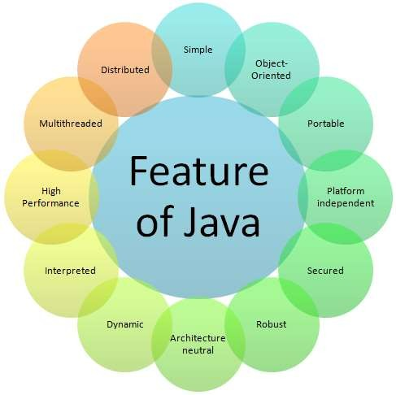
Java Buzzwords

Slide 78
Java Buzzwords
Simple
Java is a simple Language because it contains many features of other Languages like C and C++ and removes complexity because it doesn’t support pointers, storage classes, goto statements and multiple inheritances.
Object Oriented
Java is purely an Object Oriented Programming language i.e., all the code of the Java language is written into the classes and objects.

Slide 79
Java Buzzwords
Distributed
Java is a distributed language because, because of its ability to share the data and programs over the LAN.
Access remote objects.
Multithreaded
A Java program can be divided into multiple threads assigning different tasks for different threads and have all the threads executing in parallel.

Slide 80
Java Buzzwords
Dynamic
The JVM maintains a lot of runtime information about the program and the objects in the program.
Libraries are dynamically linked during runtime.
Architecture Neutral
Java follows “Write-once-run-anywhere” approach.
Java programs are compiled into byte code format which does not depend on any machine architecture but can be easily translated into a specific machine by a JVM for that machine.

Slide 81
Java Buzzwords
Portable
In Java the size of the primitive data types are machine independent.
Int in Java is always a 32-bit integer, and float is always a 32-bit IEEE 754 floating point number.
Interpreted & High Performance
Java programs are compiled to portable intermediate form known as byte codes, rather than to native machine level instructions and JVM executes the byte codes on any machine on which it is installed.
Just-in-time compiler.

Slide 82
Java Buzzwords
Robust
A Program or an application is said to be robust (reliable) when it is able to give some response in any kind of context.
Java’s features help to make the programs robust. Some of those features are: type checking, exception handling, etc.
Secured
Java provides data security through encapsulation.

Slide 83
Java Buzzwords
Interpreted
A Program or an application is said to be robust (reliable) when it is able to give some response in any kind of context.
Java’s features help to make the programs robust. Some of those features are: type checking, exception handling, etc.
Secured
Java provides data security through encapsulation.

Slide 84
Exercises
Write a program that obtains hours and minutes from seconds using java operators
Write a program that converts a Fahrenheit degree to Celsius.
Write a java program that takes your first name and last name as command line arguments to the program and displays your name and last name on separate lines.
Write a program to print factorial of a number using loops.
Write a program that prompts the user to enter an integer from console. If the number is a multiple of 5, print HiFive. If the number is divisible by 2, print HiEven
Write a program print odd and even numbers in the following format using continue – break – label
0 1
2 3
4 5
6 7
8 9

Slide 85

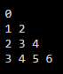
Set up an array to hold the following values, and in this order: 23, 6, 47, 35, 2, 14. Write a Java program to print out the highest number in the array.
Write a Java Program To Print Sum Of Upper Triangular Matrix
Write a Java Program to sort the numbers using bubble sort.
Write a Java program to print the numbers in the following format using Ragged array

Slide 86
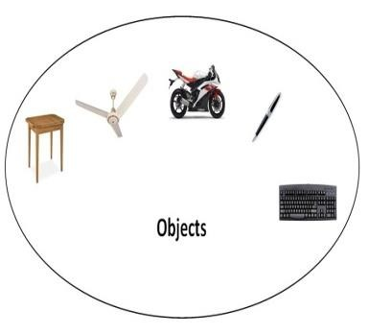
Object in Java
Object is the physical as well as logical entity
An entity that has state and behavior is known as an object e.g. chair, bike, marker, pen, table, car etc. It can be physical or logical (tengible and intengible). The example of integible object is banking system.
An object has three characteristics:
state: represents data (value) of an object.
behavior: represents the behavior (functionality) of an object such as deposit, withdraw etc.
identity: Object identity is typically implemented via a unique ID. The value of the ID is not visible to the external user. But, it is used internally by the JVM to identify each object uniquely.
For Example: Pen is an object. Its name is Reynolds, color is white etc. known
as its state. It is used to write, so writing is its behavior.

Slide 87
Objects
Class Name: Circle
Data Fields:
radius is
Methods: getArea
A class template
Circle Object 1
Data Fields: radius is 10
Circle Object 2
Data Fields: radius is 25
Circle Object 3
Data Fields: radius is 125
Three objects of the Circle class
An object has both a state and behavior. The state defines the object, and the behavior defines what the object does

Slide 88
Class in Java
Object is an instance of a class. Class is a template or blueprint from which objects are created. So object is the instance(result) of a class.
A class is a group of objects that has common properties. It is a template or blueprint from which objects are created. A class in java can contain:
data member
method
constructor
block
class and interface
Circle
centre radius
circumference() area()
Class->
Data member/s->
Method/s->

Slide 89
Classes
class Circle {
/** The radius of this circle */
double radius = 1.0;
Data field
/** Construct Circle() { } | a | circle | object | */
/** Construct | a | circle | object | */
Constructors
Circle(double newRadius) { radius = newRadius;
}
/** Return the area of this circle */
double getArea() {
Method
return radius * radius * 3.14159;
}
}

Slide 90
Methods in Java
What is System.out.println? It is a method: a collection of statements that performs a sequence of operations to display a message on the console. It can be used even without fully understanding the details of how it works. It is used by invoking a statement with a string argument. The string argument is enclosed within parentheses. In this case, the argument is "Welcome to Java!" You can call the same println method with a different argument to print a different message.

Slide 91
Adding Methods to Class Circle
public class Circle {
public double x, y; // centre of the circle
public double r; // radius of circle
//Methods to return circumference and area public double circumference() {
return 2*3.14*r;
}
public double area() {
return 3.14 * r * r;
}
}

Slide 92
Creating objects of a class
aCircle = new Circle();
bCircle = new Circle() ;
Objects are created dynamically using the new keyword.
aCircle and bCircle refer to Circle objects.
aCircle = new Circle() ; bCircle = new Circle() ;

Slide 93
Creating objects of a class
aCircle = new Circle();
bCircle = new Circle() ;
bCircle = aCircle;
Before Assignment
After Assignment
aCircle
bCircle
aCircle
bCircle
P
Q
P
Q

Slide 94
Accessing Object/Circle Data
Similar to C syntax for accessing data defined in a structure.
Circle aCircle = new Circle();
aCircle.x = 2.0; // initialize center and radius
aCircle.y = 2.0;
aCircle.r = 1.0;
Executing Methods in Object/Circle
double area;
aCircle.r = 1.0;
area = aCircle.area();

Slide 95
Using Circle Class
// Circle.java: Contains both Circle class and its user class
//Add Circle class code here class MyMain{
public static void main(String args[])
{
Circle aCircle; // creating reference
aCircle = new Circle(); // creating object aCircle.x = 10; // assigning value to data field aCircle.y = 20;
aCircle.r = 5;
double area = aCircle.area(); // invoking method
double circumf = aCircle.circumference();
System.out.println("Radius="+aCircle.r+" Area="+area);
System.out.println("Radius="+aCircle.r+" Circumference ="+circumf);
} }

Slide 96
Thank you
DEPARTMENT OF COMPUTER SCIENCE AND ENGINEERING

